Slide 1
Fraternal Life Service Home
Home for the Mentally Challenged Person
Started in 1983
A Unit of
Pondicherry Multipurpose Social Service Society (PMSSS)
#81, Laporte Street, Pondicherry.
www.pmsss.org.in

Slide 2
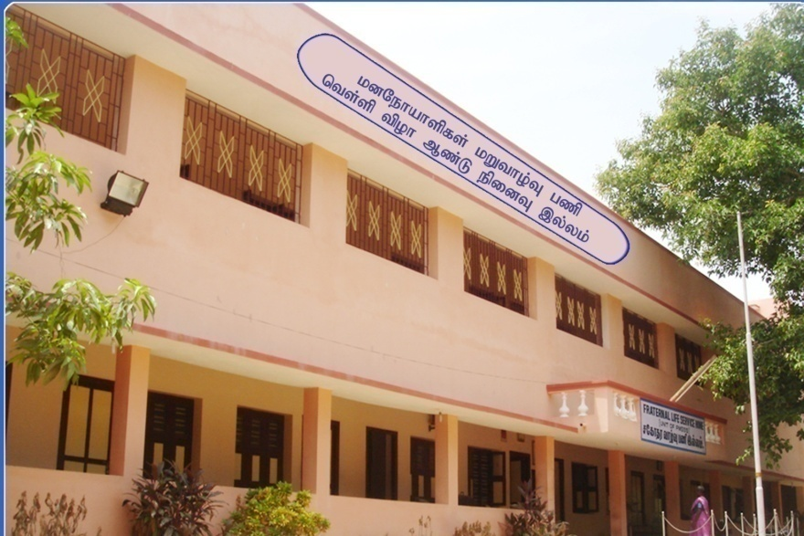
Fraternal Life Service Home (FLSH)

Slide 3
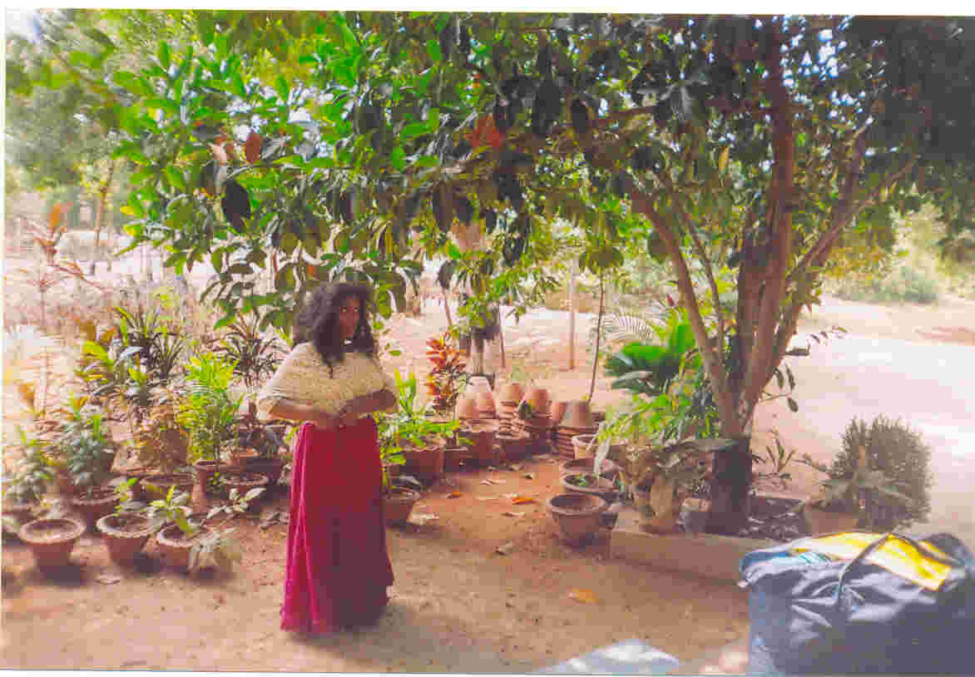
Street Patient in the Home

Slide 4
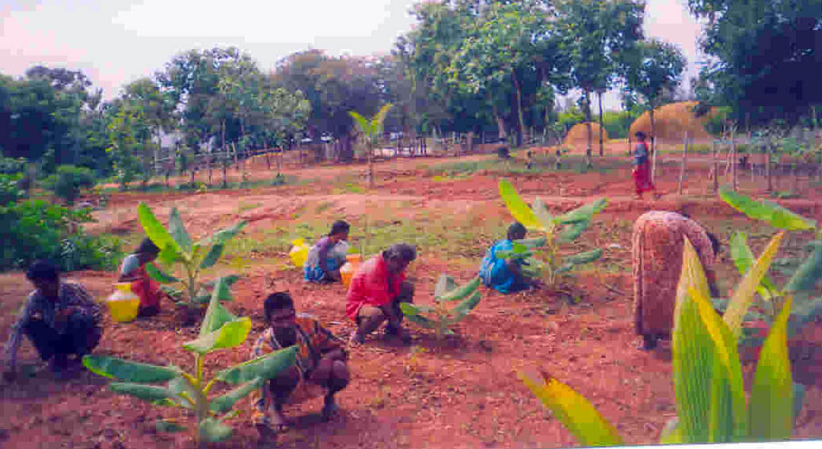
Gardening Work by the Inmates

Slide 5
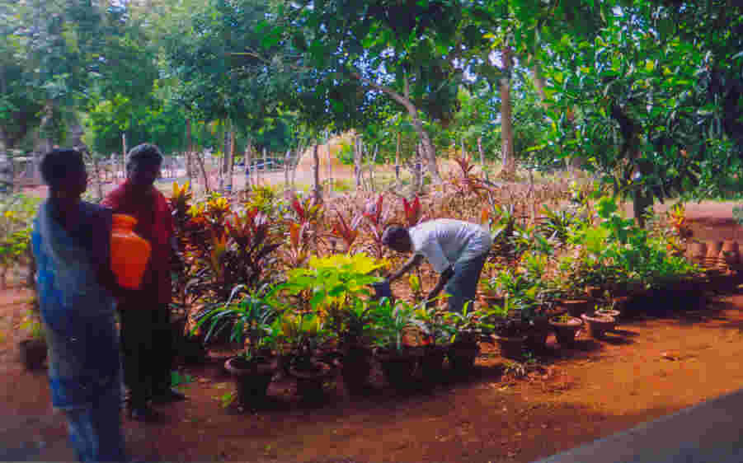
Gardening Work by the Inmates

Slide 6
Support from the Communities

Slide 7
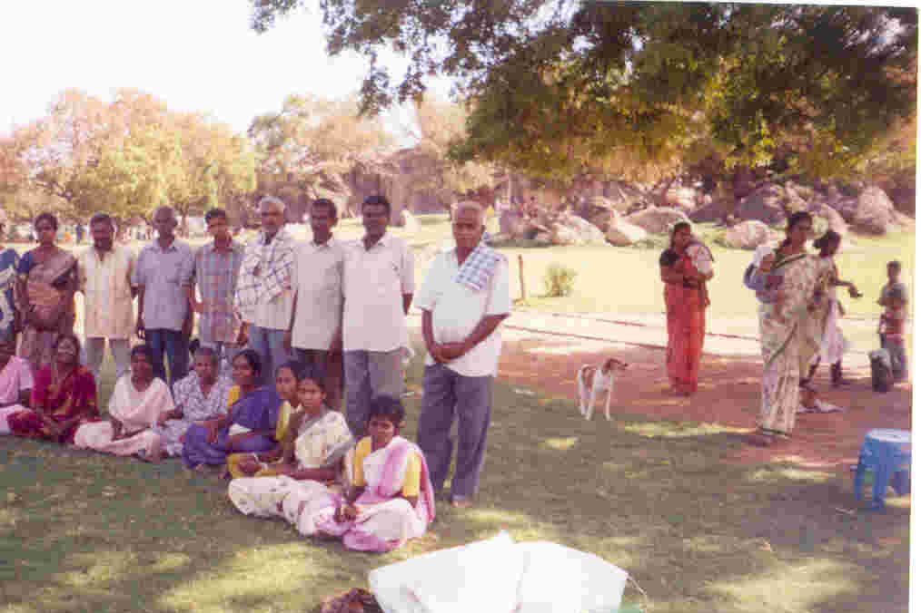
Mentally ill brethren relaxing in tourist place

Slide 8
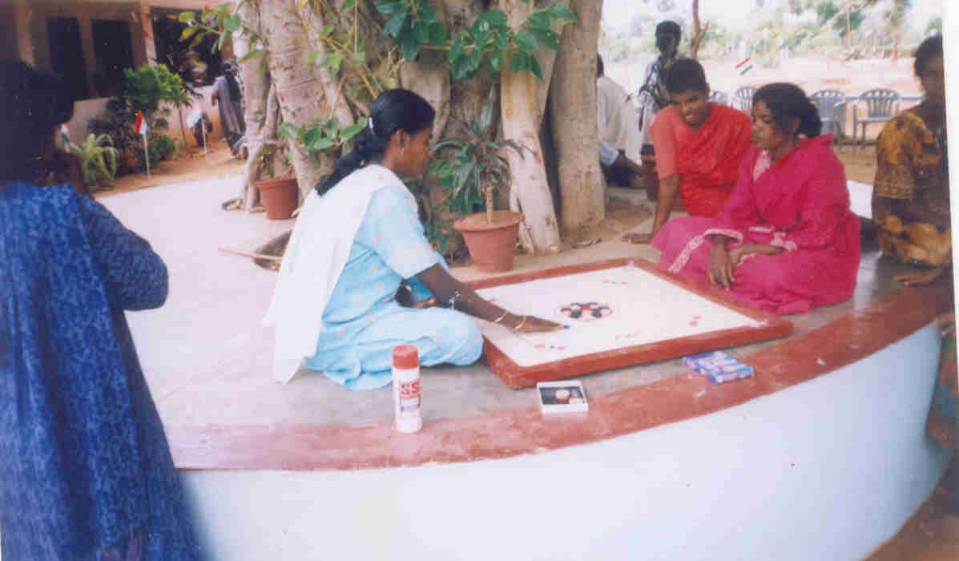
Extra Curricular Activities

Slide 9
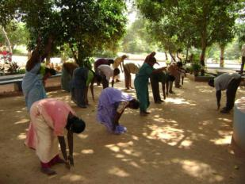
Daily Exercise

Slide 10
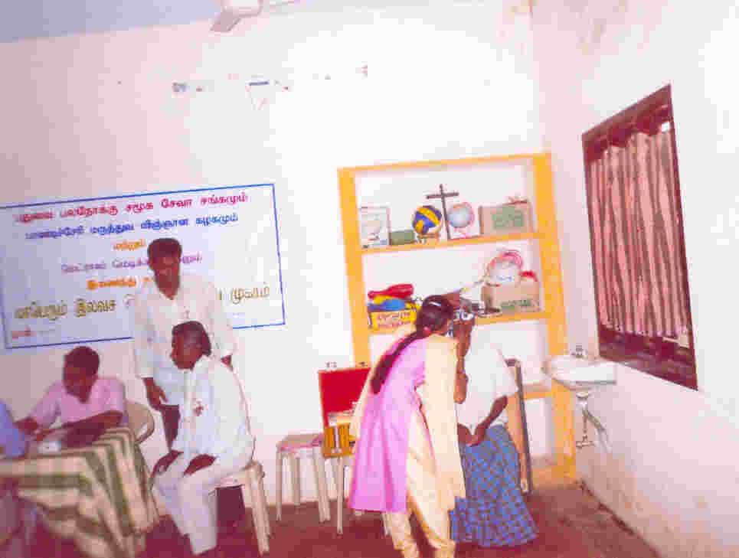
Health Check Up

Slide 11
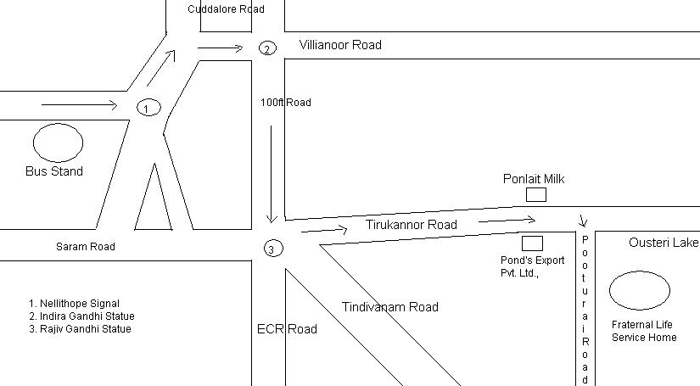
Route Map of the Home

Slide 12
Thank You

